Slide 1
8051 Instruction set

Slide 2
MNEMONIC DESTINATION OPERAND, SOURCE OPERAND
A simple instruction consists of just the opcode. Other instructions may include one or more operands.
Instruction can be one-byte instruction, which contains only opcode, or
Two-byte instructions, where the second byte is the operand or
Three byte instructions, where the operand makes up the second and third byte.
Based on the operation they perform, all the instructions in the 8051 Microcontroller Instruction Set are divided into five groups.

Slide 3
8051 Instruction set
Data Transfer Instructions
Arithmetic Instructions
Logical Instructions
Boolean or Bit Manipulation Instructions
Program Branching Instructions

Slide 4
Data Transfer Instructions
The Data Transfer Instructions are associated with transfer of data between registers or external program memory or external data memory. The Mnemonics associated with Data Transfer are given below.
MOV
MOVC
MOVX
PUSH
POP
XCH
XCHD

Slide 5
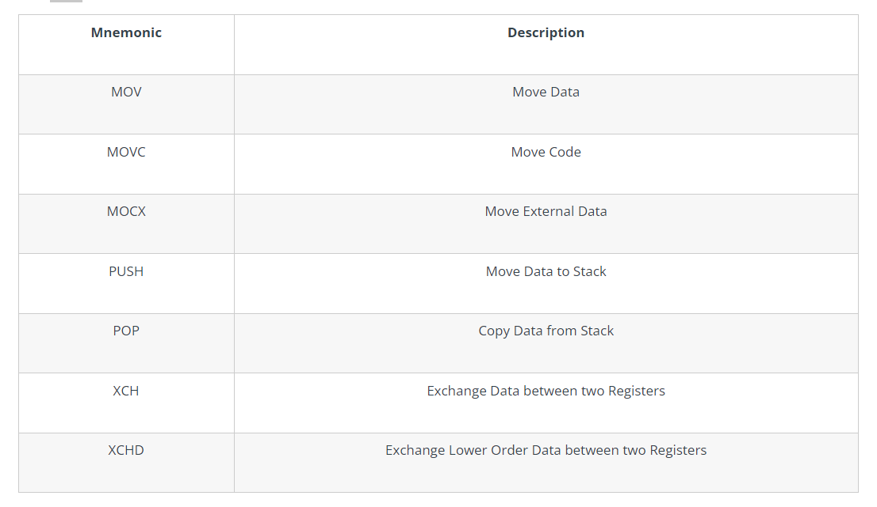
Data Transfer Instructions

Slide 6
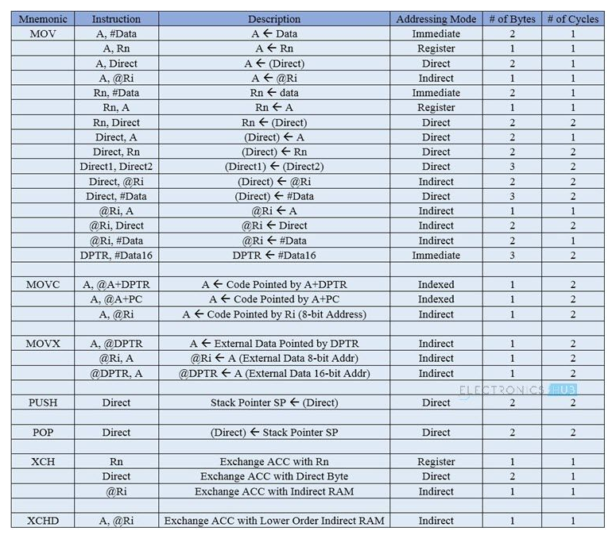
The following table lists out all the possible data transfer instructions along with other details like addressing mode, size occupied and number machine cycles it takes.

Slide 7
Arithmetic Instructions
Using Arithmetic Instructions, you can perform addition, subtraction, multiplication and division. The arithmetic instructions also include increment by one, decrement by one and a special instruction called Decimal Adjust Accumulator.
The Mnemonics associated with the Arithmetic Instructions of the 8051 Microcontroller Instruction Set are:
ADD
ADDC
SUBB
INC
DEC
MUL
DIV
DA A

Slide 8
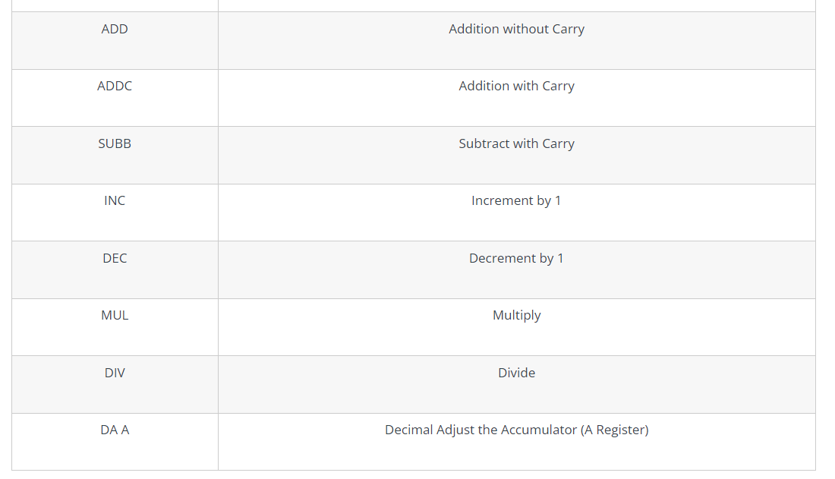
Arithmetic Instructions

Slide 9
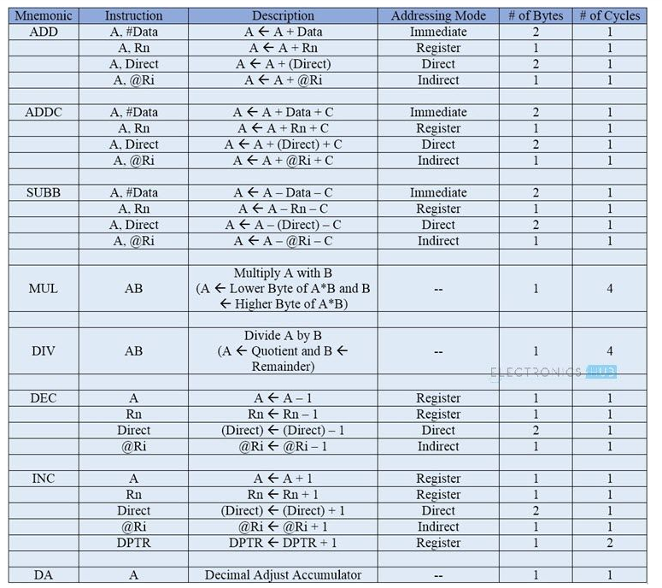
The arithmetic instructions have no knowledge about the data format i.e., signed, unsigned, ASCII, BCD, etc. Also, the operations performed by the arithmetic instructions affect flags like carry, overflow, zero, etc. in the PSW Register. All the possible Mnemonics associated with Arithmetic Instructions are mentioned in the following table.

Slide 10
Logical Instructions
The next group of instructions are the Logical Instructions, which perform logical operations like AND, OR, XOR, NOT, Rotate, Clear and Swap. Logical Instruction are performed on Bytes of data on a bit-by-bit basis.
Mnemonics associated with Logical Instructions are as follows:
ANL
ORL
XRL
CLR
CPL
RL
RLC
RR
RRC
SWAP

Slide 11
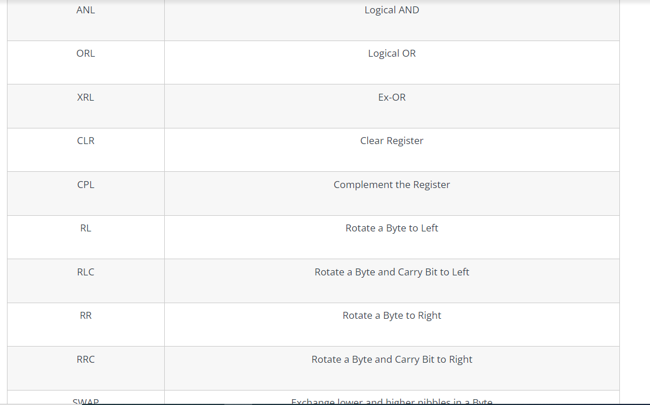
Logical Instructions

Slide 12
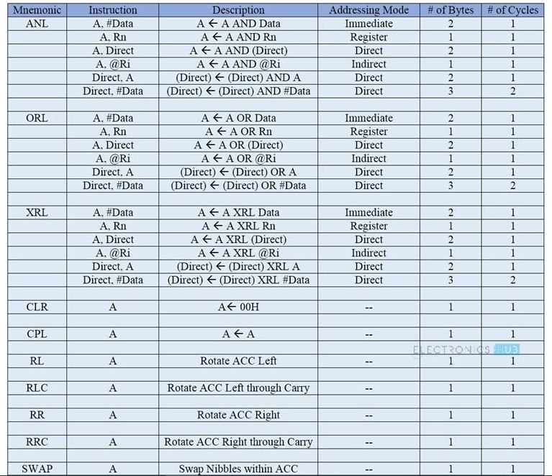
The following table shows all the possible Mnemonics of the Logical Instructions.

Slide 13
Boolean or Bit Manipulation Instructions
As the name suggests, Boolean or Bit Manipulation Instructions deal with bit variables. We know that there is a special bit-addressable area in the RAM and some of the Special Function Registers (SFRs) are also bit addressable.
The Mnemonics corresponding to the Boolean or Bit Manipulation instructions are:
CLR
SETB
MOV
JC
JNC
JB
JNB
JBC
ANL
ORL
CPL

Slide 14
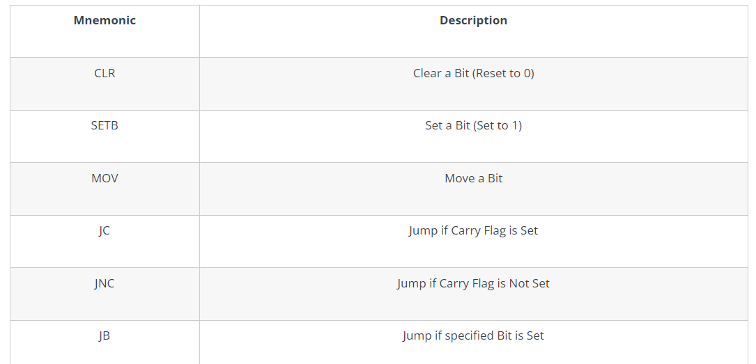
Boolean or Bit Manipulation Instructions

Slide 15
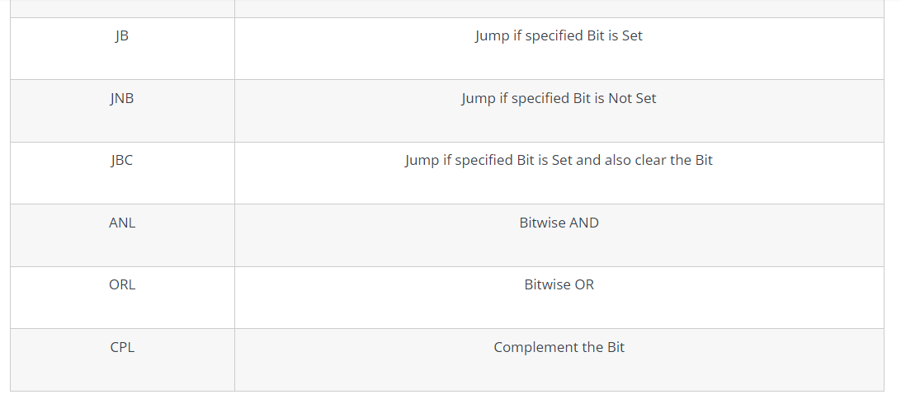
Boolean or Bit Manipulation Instructions

Slide 16
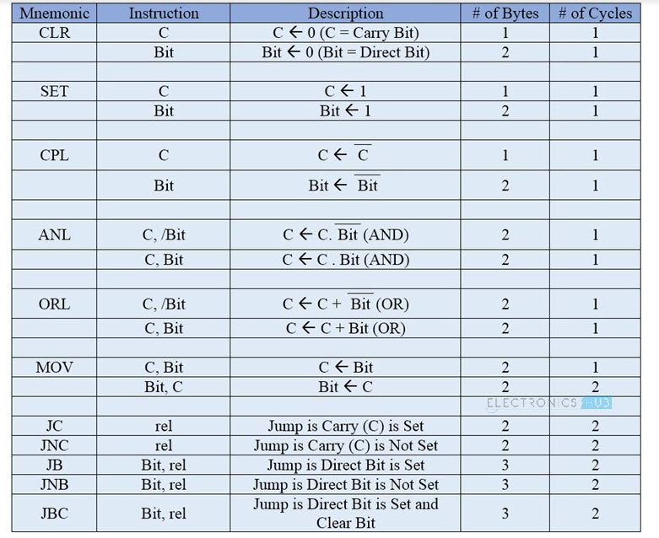
These instructions can perform set, clear, and, or, complement etc. at bit level. All the possible mnemonics of the Boolean Instructions are specified in the following table.

Slide 17
Program Branching Instructions
The last group of instructions in the 8051 Microcontroller Instruction Set are the Program Branching Instructions. These instructions control the flow of program logic. The mnemonics of the Program Branching Instructions are as follows.
LJMP
AJMP
SJMP
JZ
JNZ
CJNE
DJNZ
NOP
LCALL
ACALL
RET
RETI
JMP

Slide 18
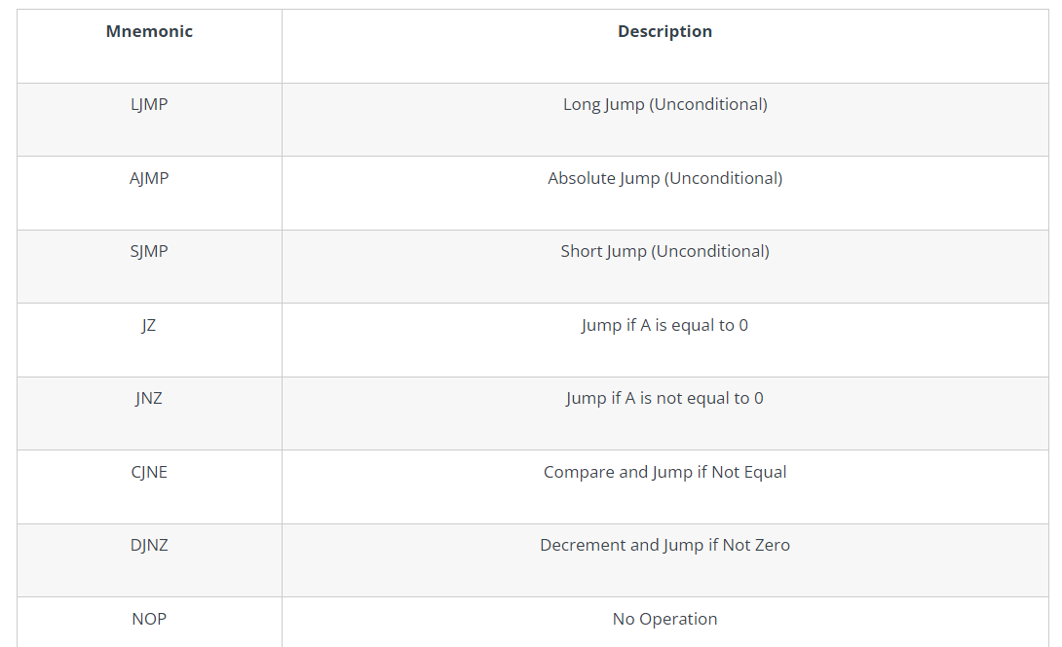
Program Branching Instructions

Slide 19
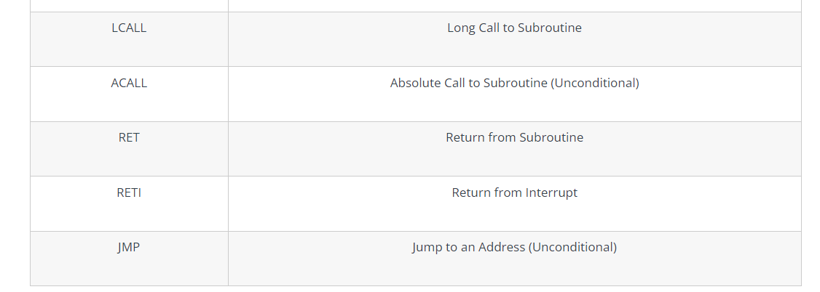
Program Branching Instructions

Slide 20
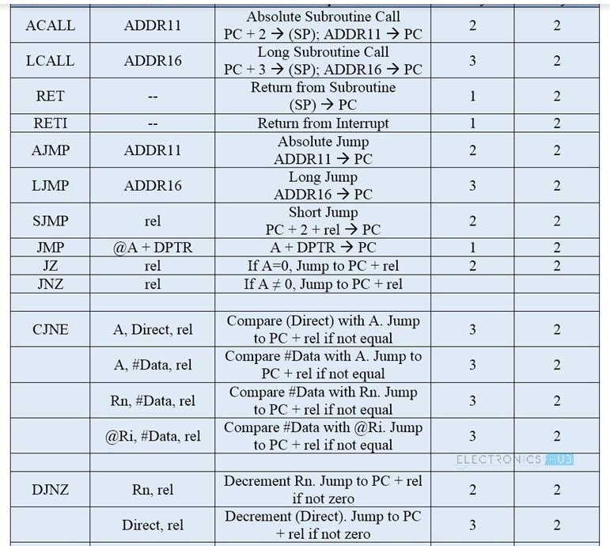
The following table shows all the mnemonics with respect to the program branching instructions.

